Slide 1

Stock Market Predictions with Artificial Intelligence - Group Project
Lange, Jennifer Sissi, Jade Lu

Slide 2

Content
Topic and goal
Dataset, Dataset extraction and analysis
Function of the models
Concept of analysis and evaluation of the models
Result
Conclusion

Slide 3

Topic and goal
The topic of our project was to create an AI model that can predict whether the stock market will rise or fall.
The goal is to help users make better decisions on buying or selling their stocks based on our model.

Slide 4



Datasets
The stock datasets used to train and test our AI model were Tesla, Samsung, and Twitter.
Tesla: June 2010 - Feb. 2020
Samsung: Jan. 2000 – May 2022
Twitter: Nov. 2013 – Oct. 2022
The original features used were date, open, high, low, close, volume.

Slide 5
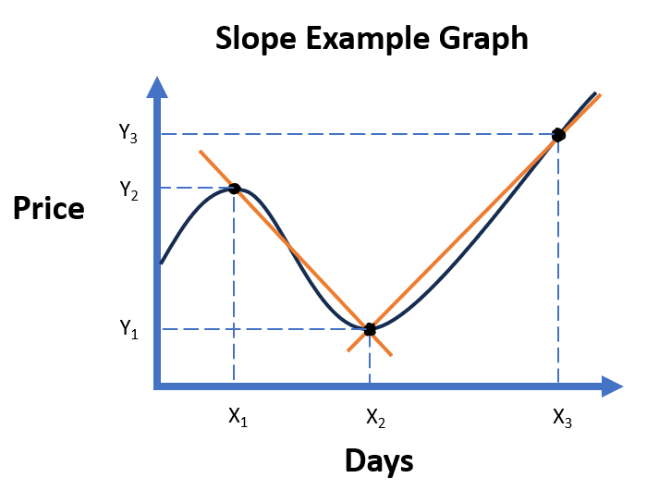
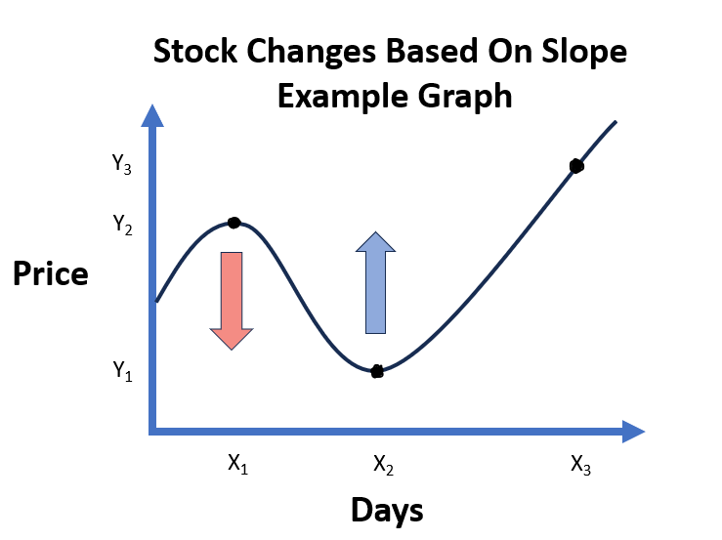
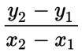
Data extraction
The modified features created and used:
Slope/rate of change
average slope
number of rises and falls
difference between high and low
average difference between high and low
difference between open and close
average difference between open and close
labels
The main formula used was this:

Slide 6

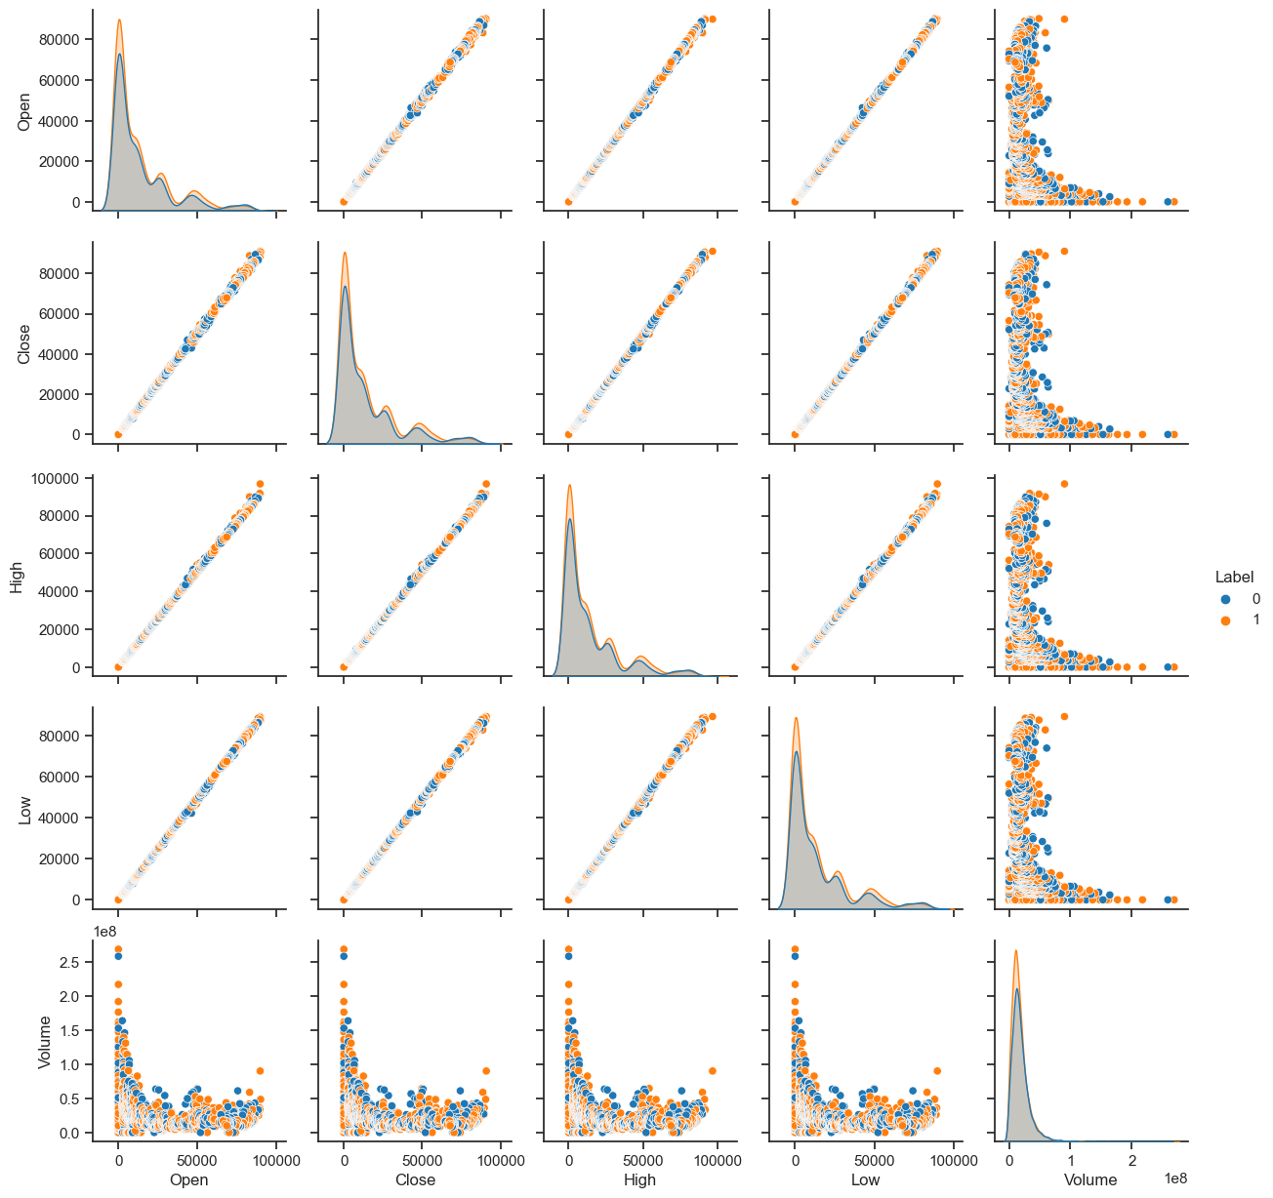
Data analysis

Slide 7
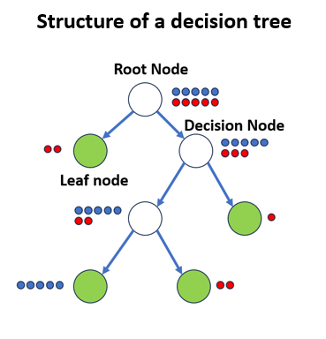
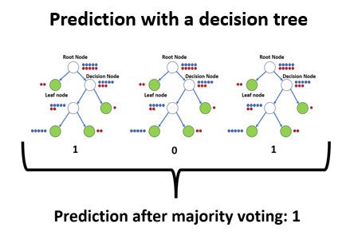
Function of the model

Slide 8
Concept of analysis and evaluation of the models

Slide 9
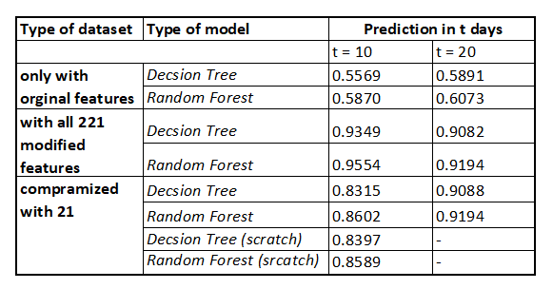
Results

Slide 10
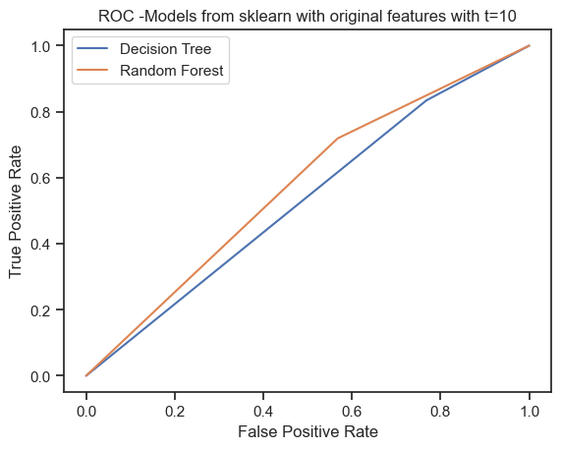
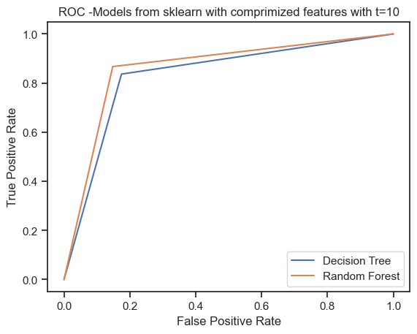
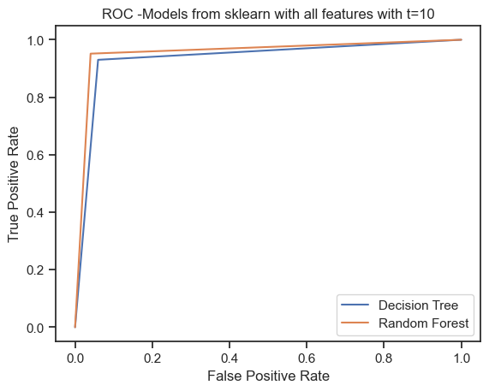
Results

Slide 11
Conclusion

Slide 12

Thank you for your attention! Do you have any questions?
https://dev.to/theinterviewsage/do-you-have-any-questions-for-me-facebook-behavioral-jedi-interview-series-1dpa

